Slide 1

ALOHA!!!
Notes:
Aloha awakea kakou! My name is Scott Derrickson and I am the Senior Planner for the State Land Use Commission

Slide 2

WE ARE THE STATE LAND USE COMMISSION (LUC)
Notes:
9 members of the public; unpaid volunteers, appointed by the Governor and confirmed by the Senate

Slide 3
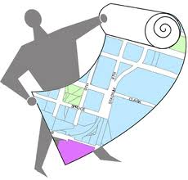
WE OVERSEE LAND USE DESIGNATIONS IN THE STATE OF HAWAI`I
Notes:
Since 1961, the LUC has been the first of its kind nationwide, to classify all lands within a State into districts based on their resources and development potential

Slide 4
OUR JOB IS TO
CONTROL DEVELOPMENT AND PROTECT OUR NATURAL RESOURCES
FOR FUTURE GENERATIONS
Notes:
The location, the pace, and the process of development in Hawai`i affects everyone in this room and will continue to affect them into the future. Development brings jobs, new housing opportunities, upgraded infrastructure; but it can also bring increased traffic, higher taxes, impacts on and access to beaches and other natural resources, and impacts to our cultural sites and practices.

Slide 5

WHY ARE WE HERE TODAY???
Notes:
The LUC has been making these important decisions for over 50 years and continues to wrestle with balancing the need for economic development, housing, and jobs with protection of all the natural and cultural resources that make Hawai`i special.

Slide 6
WE WANT TO
HELP THE PUBLIC
GET AND STAY INVOLVED
WITH PROTECTING HAWAII’S FUTURE
Notes:
With the small professional staff we have, there are physical limitations on how many requests for information that we are able to handle over the phone, over the counter, or by regular or e-mail. By making that process more efficient and user-friendly with an on-line service we can potentially help more people be part of an important decision-making process that affects their lives. The decisions made at the LUC affect the future character of the Hawai`i that all of us will live in.

Slide 7

WHAT IS OUR PROBLEM???
Notes:
We are looking for digital solutions that might make the process easier for the public to get information about development proposals, request specific services, or provide us with important information.

Slide 8


WE ARE THE
PUBLIC RESOURCE
FOR INFORMATION REGARDING DEVELOPMENT AND
LAND USE DESIGNATIONS
Notes:
A part of our mission is to make all of the information that is considered by the LUC in making development decisions, available and accessible to the public in a format and in a way that allows them to provide input before decisions are made.

Slide 9
THE NEED FOR
OUR INFORMATION IS CONSTANT AND DEVELOPMENT CHANGE IS CONTROVERSIAL
Notes:
Make information accessible to the public, businesses, and government agencies in near real-time so that they can provide their voices and ensure the best information is used by the LUC to make those difficult decisions.

Slide 10
CITIZENS NEED TO
GET INFORMATION,
CONTRIBUTE PUBLIC TESTIMONY OR
SUBMIT DOCUMENTATION TO US
Notes:
Find solutions that could guide interested parties or members of the public with a simple series of questions to request services or provide information to the LUC regarding ongoing development proposals.

Slide 11

WHY DO WE NEED HELP???
Notes:
We have a certain level of technical expertise on staff, but we readily admit that we are way out of our ability to figure out or create possible solutions for our workflow processes.

Slide 12

WE WANT OUR WEBSITE TO BE USED TO
REQUEST INFORMATION,
SUBMIT PUBLIC TESTIMONY, OR
FILE DOCUMENTS

Slide 13
CREATE GREAT PUBLIC BENEFIT-
DOCUMENTS ACCESSED OR SUBMITTED 24/7- 365
FANTASTIC TRANSPARENCY
BETTER INFO SHARING- BETTER DECISION-MAKING
LUC STAFF CAN BETTER REACT AND RESPOND
Notes:
The results would be:
No limitation on the public’s ability to provide input or get access to information
Improve transparency in government decision making
Better Decision Making relies on receiving a diversity of information
LUC staff will be able to handle information and service requests more efficiently and assist more people

Slide 14
THE PUBLIC WOULD
GET BETTER INFORMATION
COULD ASK BETTER QUESTIONS,
SEEK BETTER ANSWERS, AND
BE SURE THEIR VOICES ARE HEARD BEFORE DECISIONS ARE MADE!!!
Notes:
Ultimately, the public will have timely access to important information, allow ways for them to ask about and receive answers before decisions get made.

Slide 15
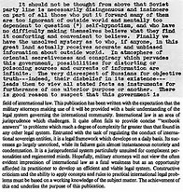
TRANSFORM OUR INFORMATION CLUTTER
Notes:
We would like to find ways to transform our information clutter

Slide 16
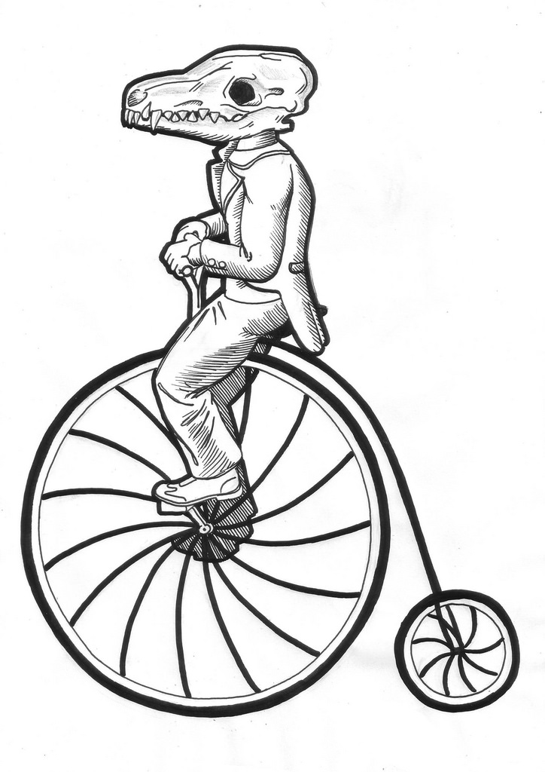

INTO A MUCH SMOOTHER
AND
SMARTER PROCESS
START
FINISH
Notes:
We hope that some of you out there might be interested in challenging yourselves in finding more effective ways for the public to access our information and provide input on developments that will affect their lives – AND YOURS TOO!

Slide 17

MAHALO!!!

